Slide 1


Politecnico di Milano
NAML PROJECT
GAN for MNIST
Abdallah Alkhetiar 10765149
Luigi Inguaggiato 10809587

Slide 2

Index
Introduction
Loss Function
Data Loading and Preprocessing
Optimization
Dataset Structure
Training
Architecture
Model Evaluation
Generator Architecture
Conclusions
Discriminator Architecture
Challenges

Slide 3

Objectives
Implement and train a GAN capable of generating realistic MNIST digit images.
Evaluate the quality of the generated images using both qualitative inspection and quantitative metrics.
Explore the impact of hyperparameter tuning on the GAN’s performance and stability.
Introduction
Return to index

Slide 4

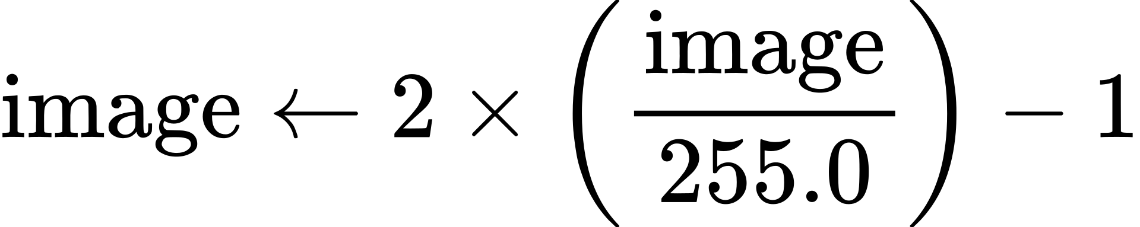
Data Loading and
Preprocessing
Dataset Loading
Load the images and labels from Kaggle.
Reshape into a set of (28, 28, 1), the last dimension is for the grayscale.
Dataset Prepocessing
Normalization:
Shuffling
Training-Validation Split: training 50000 samples, validation 10000 samples, test 10000 samples.
Return to index

Slide 5
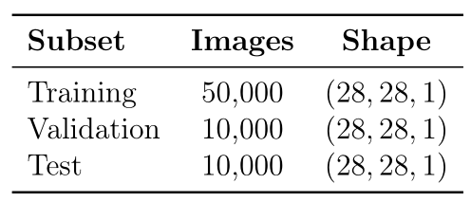
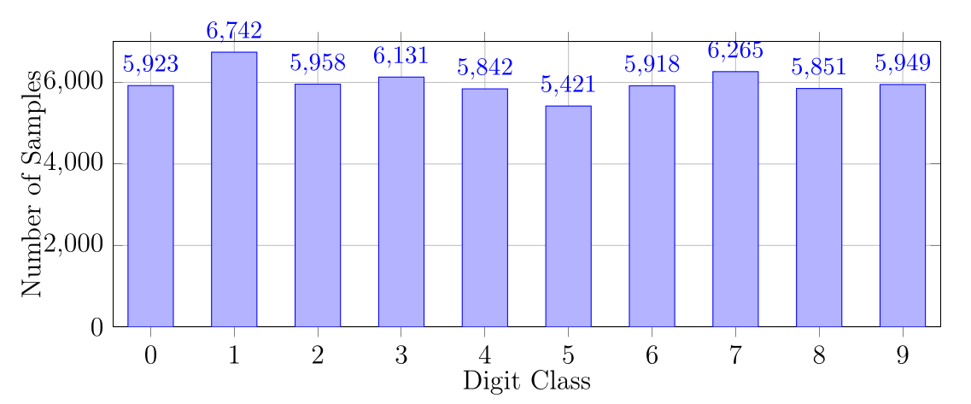
Return to index
Dataset Structure

Slide 6

Architecture
Return to index

Slide 7

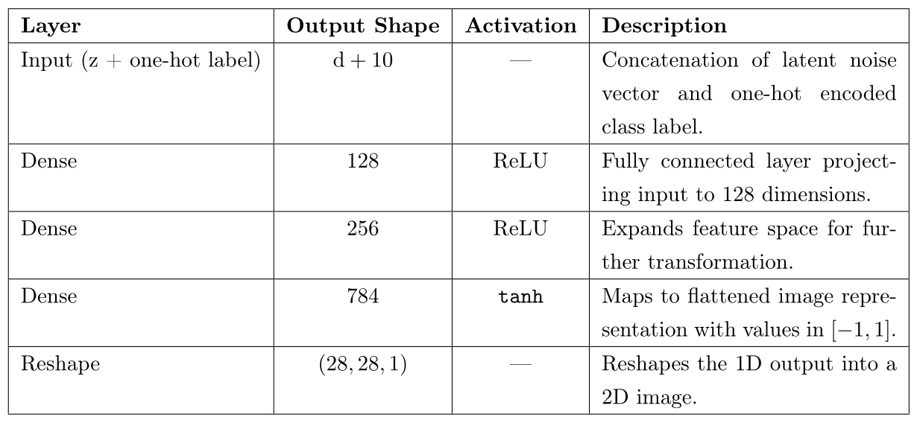
Generator
Return to index

Slide 8
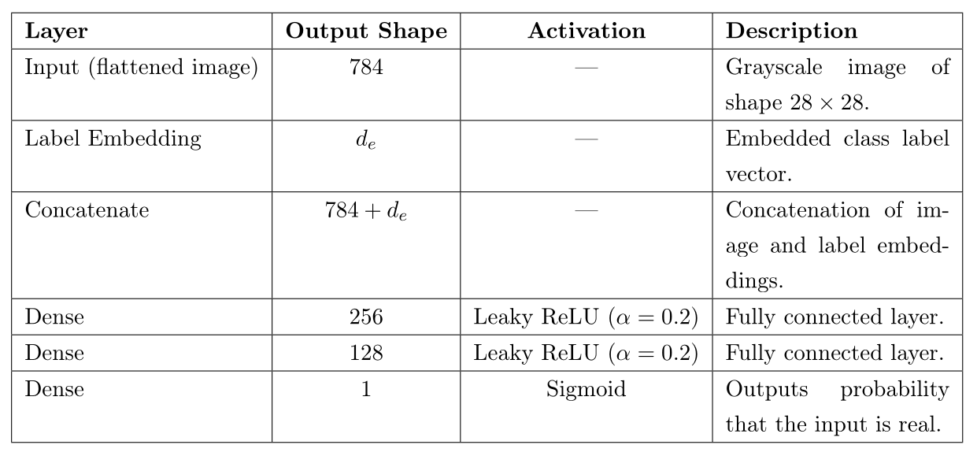
Discriminator
Return to index

Slide 9
Loss Functions
Objective Function (Binary Cross-Entropy):
Discriminator Loss:
Adversarial interplay between the generator (G) and discriminator (D)
Generator Loss:
Return to index

Slide 10
Optimization
Separate ADAM optimizers are used for the generator (G) and discriminator (D) to independently control their learning dynamics.
The optax module was used to implement the ADAM optimizer since it’s the perfect fit for the JAX library.
Return to index

Slide 11
Training
Training Loop
At each epoch:
the dataset is shuffled
it is split in batches of size 64
a fresh set of latent noise vectors z ∼ N (0, I) is sampled
For each batch the Discriminator and the Generator are trained
Discriminator learns to distinguish real images from generated ones.
Generator learns to produce realistic images to fool the discriminator.
To qualitatively monitor training, synthetic images are generated every 100 epochs using a fixed noise vector z and class labels {0, 1, ..., 9}
Return to index

Slide 12
Qualitative Evaluation
Visual inspection to assess realism and diversity
Model Evaluation
Training Dynamics Monitoring
Identify instabilities during training such as vanishing gradients, balance between generator and discriminator.
Quantitative Evaluation
Using the FID (Fréchet Inception Distance) score
10,000 real and 10,000 generated images
Calculated using pytorch-fid
Return to index

Slide 13
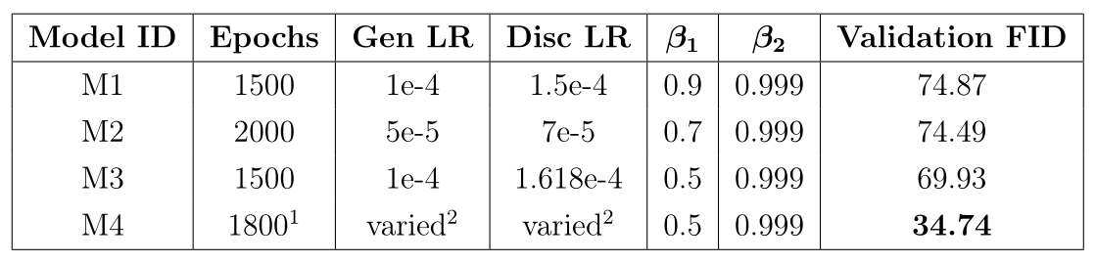
Experimental Configurations
Return to index

Slide 14
Best Model Analysis (M4)
Model M4 is configured with a scheduled learning rate and ADAM parameters β1 = 0.5, β2 = 0.999.
It was trained for 1600 epochs with a fixed learning rate, followed by 200 epochs with decaying learning rates.
Learning rate schedule:
epochs 0–1600: Gen LR = 1.5 × 10−4 , Disc LR = 2.427 × 10−4;
epochs 1600–1700: Gen LR = 5×10−5 , Disc LR = 1.427×10−4;
epochs 1700–1800: Gen LR = 2×10−5 , Disc LR = 6.45 × 10−5.
Return to index

Slide 15
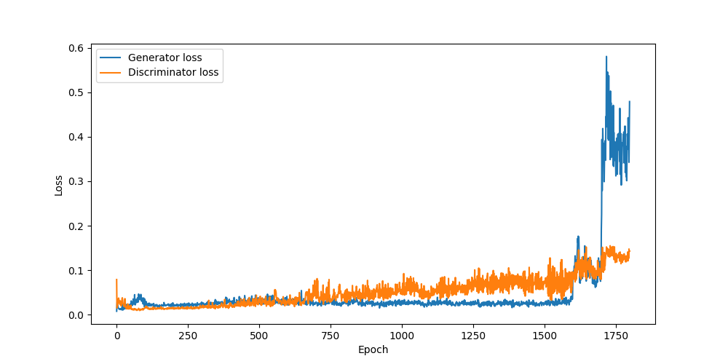
Training Dynamics
In the last epochs, we can notice a jump in the loss function since that’s when we started performing scheduling.
Return to index

Slide 16
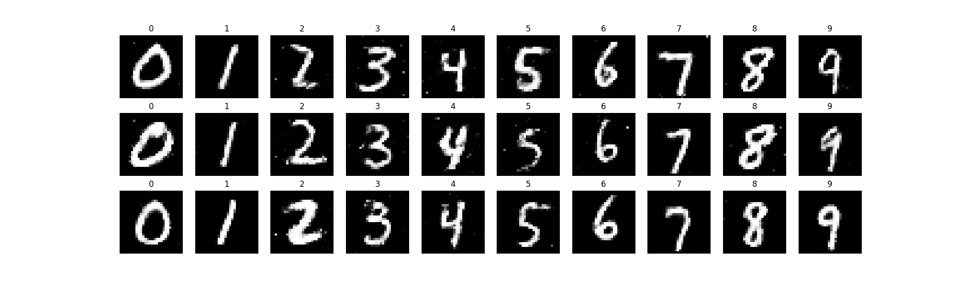
Qualitative Results
Return to index

Slide 17
Evaluation on Test Set
Model M4 was evaluated on the MNIST test set using the Fréchet Inception Distance (FID).
Test FID: 34.65
The identical score on validation and test sets indicates stable and consistent generative performance without significant overfitting.
Return to index

Slide 18
The model we have found works pretty well even if it has some room for improvement regarding the FID score, however the quality of the images is quite good.
Conclusions
This project allowed us to better understand the workflow behind building a machine learning model, all the difficulties it imposes and how to appropriately overcome them.
Return to index

Slide 19



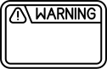
Challenges
Return to index
Training Instability
Loss Interpretation Limitations
Mode Collapse

